Slide 2

DECONSTRUCTING THE CLOUD
Side-Channel Attacks
by Aditya Wate
Image courtesy of Stuart Miles at FreeDigitalPhotos.net

Slide 3
Side Channel Attacks
Time-driven: Statistically inferring from execution timing
Trace-driven: Monitoring some aspect of the device
Access-driven: Usage of a shared architectural component

Slide 4
Setup
Dom0
DomU
DomV
VCPU
Core 0
Core 1
Core 2
L1 Inst
L1 Data
L1 Inst
L1 Data
L1 Inst
L1 Data
PCPU
L2
L2
L2
Unified L3

Slide 5
Threat Model
Attacker and Victim are separate guest VMs
Logical isolation between mutually untrusting co-resident VMs
Software vulns are not exploited to gain root of the other machine

Slide 6
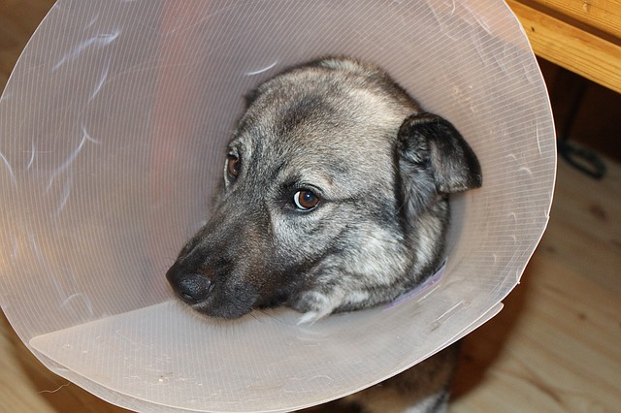

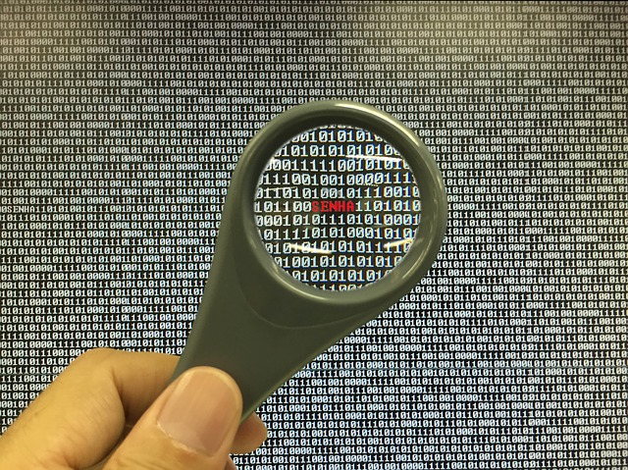
Threat Model
Victim
Attacker
Physical Machine

Slide 7
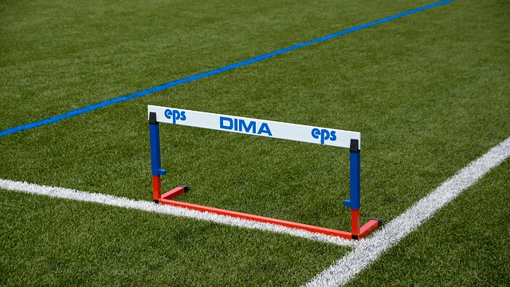
Challenges
Observation granularity: Window of observation is less
Observation noise: VMM uses L1 to reschedule
Core migration: gives way to above two

Slide 8
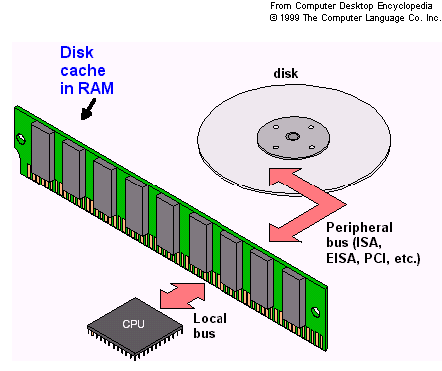
Prime-probe protocol
Priming: Filling a cache set
Probing: Measure the time it takes to fill a cache

Slide 9
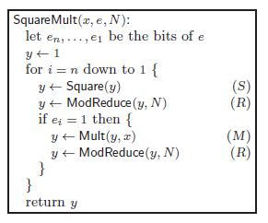
Classifying Code Paths
For e=2 the operation sequence will be SRMRSR

Slide 10
Cache pattern classifier
Classification of S,M and R vectors
Using SVM (support vector machine)
Training on a controlled but similar architecture machine
Communication of the results is required to get the readings
Utilize the memory pages shared between VMs

Slide 11
Steps
Co-resident VMs
Measurement Stage
Cross-VM side-channel probing
Inferred code-path
L1-cache measurements
Analysis Stage
Cache pattern classification
Sequences of SVM-classified labels
Noise reduction
Fragments of code-path
Code-path reassembly

Slide 12
THANKS

